Slide 1

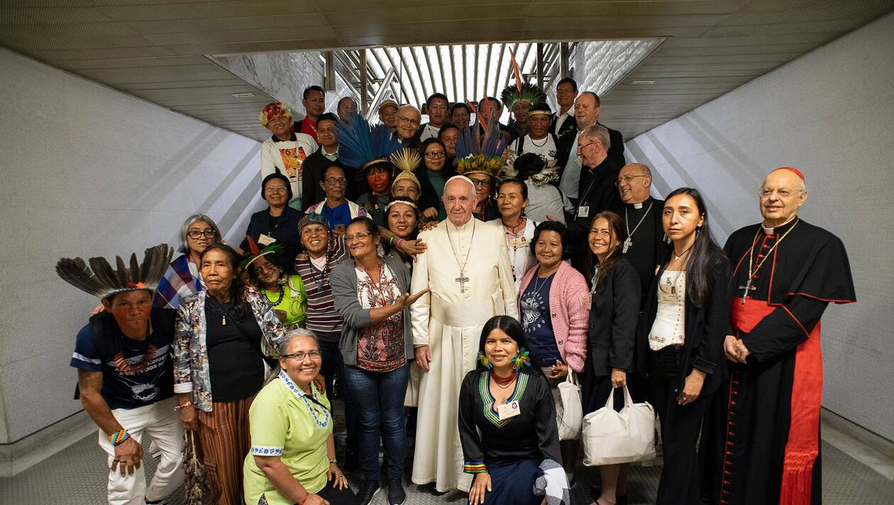
Women in the church :
The challenge of synodality
Sr Nathalie Becquart, xmcj,
Unders-Secretary to the General Secretariat of the Synod of Bishops

Slide 2
Starter
When you think about women in the church, which word or image comes to your mind?
Pop-up : Please write one word/image in the chat in your language

Slide 3
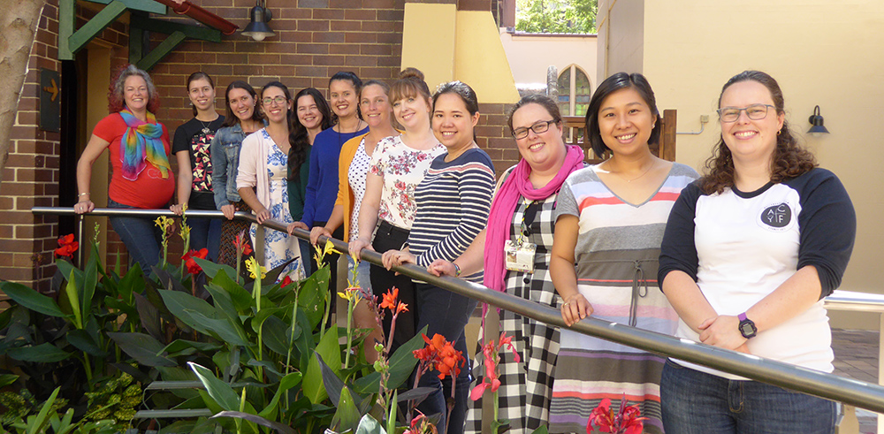
Women in the Church
A key issue, a sign of the times

Slide 4
The current context
Reflection on women in the Church within the context of society
Men and women, a new deal!
Progress under the pressure of feminism and social evolution
  Towards more parity, the challenge of diversity
  Contrary reactions and a long change of mentality #MeToo movement
  The new experience of young people
An urgent call, strong aspirations
A sign of the times

Slide 5
A church attentive to the signs of the times Christus Vivit §42
A living Church can react by being attentive to the legitimate claims of those women who seek greater justice and equality. A living Church can look back on history and acknowledge a fair share of male authoritarianism, domination, various forms of enslavement, abuse and sexist violence. With this outlook, she can support the call to respect women’s rights, and offer convinced support for greater reciprocity between males and females, while not agreeing with everything some feminist groups propose. Along these lines, the Synod sought to renew the Church’s commitment “against all discrimination and violence on sexual grounds”.[17] That is the response of a Church that stays young and lets herself be challenged and spurred by the sensitivities of young people.

Slide 6
The ecclesial context
The Context of the Sexual Abuse and Abuse of Power Crisis
A greater awareness of the issues
A major issue and very strong calls during the last two synods
The question of women is being raised today not only by women but also more and more by men, priests, bishops, cardinals... and also by Pope Francis

Slide 7
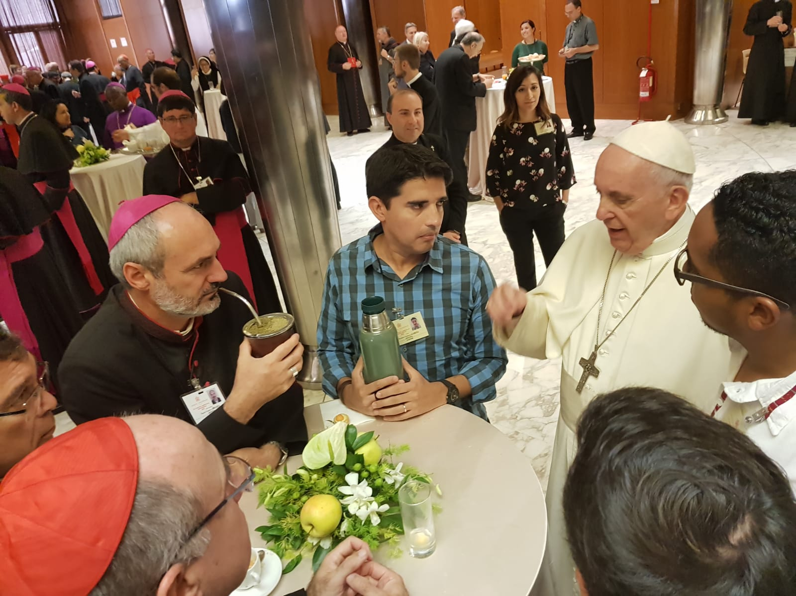
Called to become a synodal church to serve the world
« A Church constitutively synodal »

Slide 8
Synodality is a call of God
“The world in which we live, and which we are called to love and serve, even with its contradictions, demands that the Church strengthen cooperation in all areas of her mission. It is precisely this path of synodality which God expects of the Church of the third millennium.”
Pope Francis
Address at the Ceremony Commemorating the 50th Anniversary
of the Institution of the Synod of Bishops, October 17 2015

Slide 9
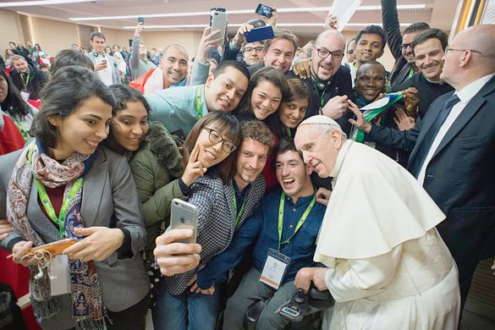
The dream of an inclusive church
“Young people and elder together in a synodal church ”
Men and women together
Lay, consecrated, clergy, all baptized missionary disciples
Notes:
The meeting between generations can be extremely fruitful for giving rise to hope. The prophet Joel teaches us this – I reminded young people at the pre-Synod meeting – and I consider it the prophecy of our time: “Your old men shall dream dreams, and your young men shall see visions” (2:28) and they will prophesy.
Address of Pope Francis at the opening of the synod on youth, 3 October 2018
Cf CV Chapter 6 “Young People with Roots”
The profecy of Joël in Act 2, 17 → CV 192 « The old dream dreams and the young see visions. How do we complement each other? »
CV 199 “If we journey together, young and old, we can be firmly rooted in the present, and from here, revisit the past and look to the future. (…) Together, we can learn from one another, warm hearts, inspire minds with the light of the Gospel, and lend new strength to our hands. “

Slide 10
Women in a synodal Church
148. A Church that seeks to live a synodal style cannot fail to reflect on the condition and role of women within it, and consequently in society more generally. Young men and women ask this question forcefully. The fruits of such reflection need to be implemented through a courageous change of culture and through change in daily pastoral practice.

Slide 11
Women in a synodal Church
§148 (…) A sphere of particular importance in this regard is the female presence in ecclesial bodies at all levels, including positions of responsibility, as well as female participation in ecclesial decision-making processes, respecting the role of the ordained minister. This is a duty of justice, which draws inspiration both from the way Jesus related to men and women of his day, and from the importance of the role of certain female figures in the Bible, in the history of salvation and in the life of the Church.

Slide 12
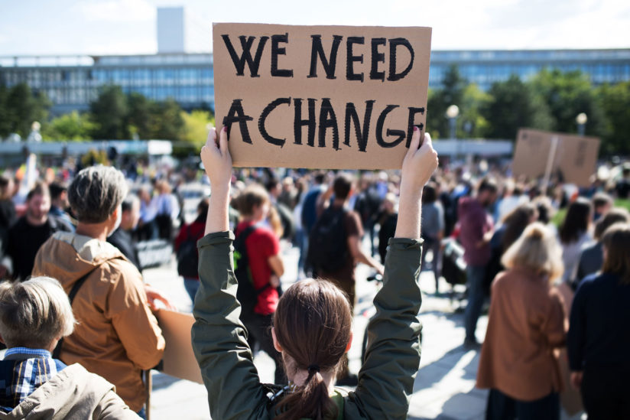
This Covid-19 crisis as an eye opener that highlights interdependency and the urgency of synodality
« we are on the same boat »
Interconnectedness
Laudato Si and Fratelli Tutti
Notes:
Paths of fraternity
CV 174. I want to encourage all of you in this effort, because I know that “your young hearts want to build a better world. I have been following news reports of the many young people throughout the world who have taken to the streets to express the desire for a more just and fraternal society. Young people taking to the streets! The young want to be protagonists of change. Please, do not leave it to others to be protagonists of change. You are the ones who hold the future! Through you, the future enters into the world. I ask you also to be protagonists of this transformation. You are the ones who hold the key to the future! Continue to fight apathy and to offer a Christian response to the social and political troubles emerging in different parts of the world. I ask you to build the future, to work for a better world. Dear young people, please, do not be bystanders in life. Get involved! Jesus was not a bystander. He got involved. Don’t stand aloof, but immerse yourselves in the reality of life, as Jesus did”.[92]

Slide 13
The challenge of putting synodality into practice
“What the Lord is asking of us is already in some sense present in the very word ‘synod’. Journeying together — laity, pastors, the Bishop of Rome — is an easy concept to put into words, but not so easy to put into practice”
Pope Francis
Address at the Ceremony Commemorating the 50th Anniversary
of the Institution of the Synod of Bishops, October 17 2015
Notes:
http://w2.vatican.va/content/francesco/en/speeches/2015/october/documents/papa-francesco_20151017_50-anniversario-sinodo.html
We must continue along this path. The world in which we live, and which we are called to love and serve, even with its contradictions, demands that the Church strengthen cooperation in all areas of her mission. It is precisely this path of synodality which God expects of the Church of the third millennium.
***
What the Lord is asking of us is already in some sense present in the very word “synod”. Journeying together — laity, pastors, the Bishop of Rome — is an easy concept to put into words, but not so easy to put into practice.

Slide 14
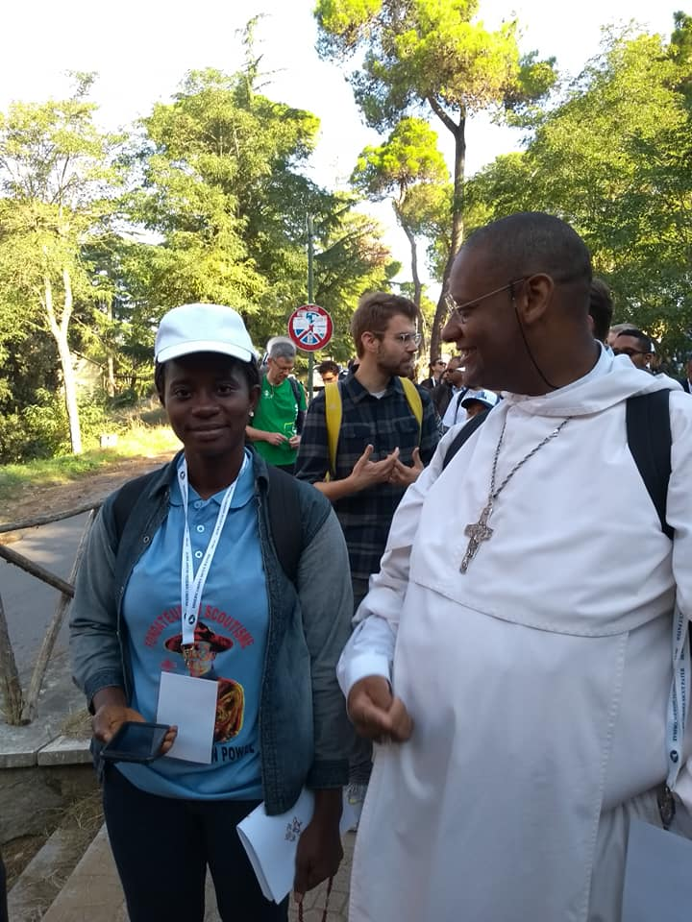
Called to walk together as brothers and sisters in Christ

Slide 15
The experience of the last 2 synods
The very positive experience of women in the last two synods in which they played a major and recognized role
Women and youth are the driving force to foster synodality
Clericalism/synodality
The role of the laity, the sensus fidei and the common priesthood of the baptized

Slide 16
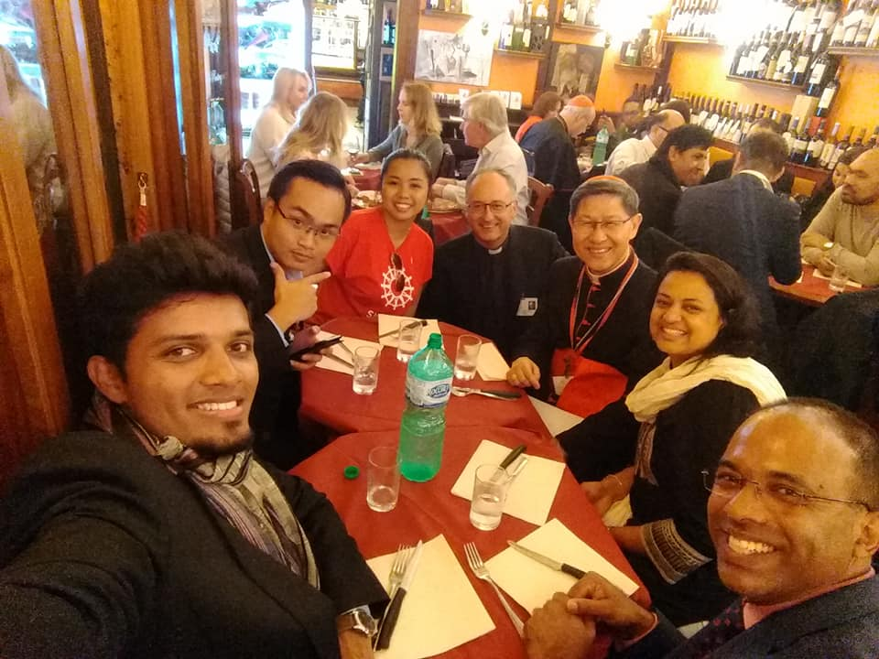
The roadmap of fraternity

Slide 17
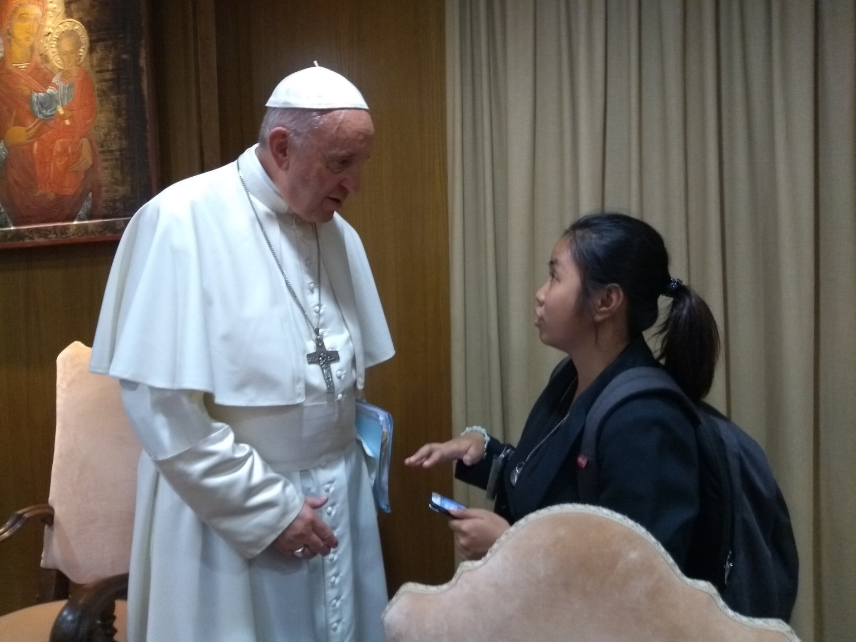
Called to be protagonists

Slide 18
A synodal journey as a path of renewal for a missionary Church
The recent Synodal Assemblies on the family (2014 and 2015) and on young people (2018) and the Special Assembly for the Amazon (2019) have shown how the Church draws from the synodal journey new awareness and new impetus to enter into that "permanent state of mission" that must animate her, to be faithful to her Lord.

Slide 19
Missionary Synodality
Spiritual, pastoral and missionary conversion
Final Document Synod on Youth §118. (…) The fruit of this Synod, the choice that the Spirit has inspired in us through listening and discernment, is to walk with the young, going out towards everyone, so as to bear witness to the love of God. We could describe this process by speaking of synodality for mission, or missionary synodality: “Making a synodal Church a reality is an indispensable precondition for a new missionary energy that will involve the entire People of God.” International Theological Commission, Synodality in the life and mission of the Church, 2 March 2018, §9
Notes:
Spiritual, pastoral and missionary conversion
118. Pope Francis often reminds us that this is not possible without a serious journey of conversion. We are aware that it is not just a question of starting up new activities, nor do we want to write “vast apostolic projects, meticulously planned, just like defeated generals” (Francis, Evangelii Gaudium, 96). We know that in order to be credible, we must live a reform of the Church, which implies purification of the heart and changes of style. The Church must truly allow herself to take on the form of the Eucharist, which she celebrates as the source and summit of her life – the form of a loaf made up of many grains and broken for the life of the world. The fruit of this Synod, the choice that the Spirit has inspired in us through listening and discernment, is to walk with the young, going out towards everyone, so as to bear witness to the love of God. We could describe this process by speaking of synodality for mission, or missionary synodality: “Making a synodal Church a reality is an indispensable precondition for a new missionary energy that will involve the entire People of God.”[1]We are dealing here with a prophecy of the Second Vatican Council, which we have yet to absorb in all its profundity and to develop in its daily implications, as Pope Francis reminds us when he says: “It is precisely this path ofsynodality which God expects of the Church of the third millennium” (Francis, Address for the Commemoration of the Fiftieth Anniversary of the Institution of the Synod of Bishops, 17 October 2015). We are convinced that this choice, a fruit of prayer and debate, will allow the Church, by God’s grace, to be and to appear more clearly as the “youth of the world”.

Slide 20
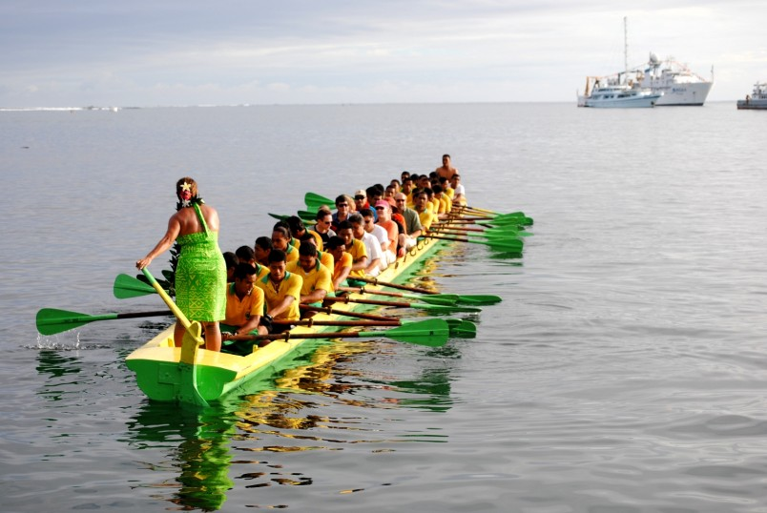
An image from Christus Vivit
Together on the same canoe !

Slide 21
Together on the same canoe !
CV 201. During the Synod, one of the young auditors from the Samoan Islands spoke of the Church as a canoe, in which the elderly help to keep on course by judging the position of the stars, while the young keep rowing, imagining what waits for them ahead. Let us steer clear of young people who think that adults represent a meaningless past, and those adults who always think they know how young people should act. Instead, let us all climb aboard the same canoe and together seek a better world, with the constantly renewed momentum of the Holy Spirit.

Slide 22
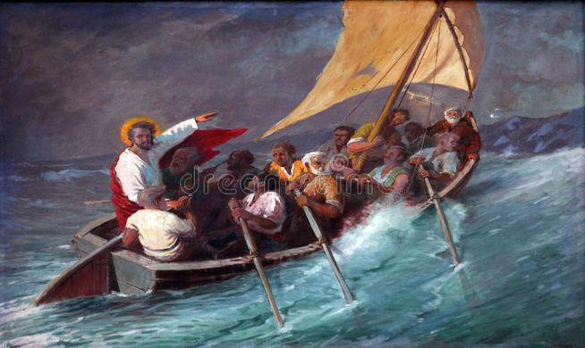
On the synodal journey, becoming a discerning church,
A church on the move,
A church on the sea

Slide 23
From a clerical church to a synodal church
A relational church
An inclusive church
A dialogal church
A discerning church
A generative church
A pluricultural church
Participation - Participation – Coministering
Protagonism – Joint responsibility - Discernment
Structure/Static → dynamism
Monolithic → polyedric
Being seated → walking together
Earth → sea
Cathedral → boat

Slide 24
Becoming a synod
“Synodality. Being Church is being a community that walks together. It is not enough to have a synod, you must be a synod. The Church needs intense internal sharing: a living dialogue between the Pastors and between the Pastors and the faithful.
Three aspects revive synodality.
  First of all, listening –
  A second aspect: co-responsibility –
  Third aspect – Synodality also means involvement of the laity: as full members of the Church, they too are called to express themselves, to give suggestions. “
  Pope Francis, Address for the Audience with the Major Archbishop, the Metropolitans and the Permanent Synod of the Ukrainian Greek-Catholic Church, July 5 2019
Notes:
Francis, Address for the Audience with the Major Archbishop, the Metropolitans and the Permanent Synod of the Ukrainian Greek-Catholic Church, July 5 2019
https://press.vatican.va/content/salastampa/en/bollettino/pubblico/2019/07/05/190705a.html
I would like to add a third word to prayer and closeness, which is so familiar to you: synodality. Being Church is being a community that walks together. It is not enough to have a synod, you must be a synod. The Church needs intense internal sharing: a living dialogue between the Pastors and between the Pastors and the faithful. As an Eastern Catholic Church, you already have a marked synodal expression in your canonical order, which calls for frequent and regular recourse to the assemblies of the Synod of Bishops. But every day we must be a synod, striving to walk together, not only with those who think in the same way – this would be easy – but with all believers in Jesus.
Three aspects revive synodality. First of all, listening: listening to the experiences and suggestions of the bishops and priests. It is important that everyone within the Synod feels they are heard. Listening is all the more important as you rise in the hierarchy. Listening is sensitivity and openness to the opinions of brothers, even those who are younger, even those who are considered less experienced. A second aspect: co-responsibility. We cannot be indifferent to the errors or the carelessness of others, without intervening in a fraternal but convinced way: our confreres need our thoughts, our encouragement, as well as our corrections, because, precisely, we are called to walk together. You cannot hide what is wrong and move on as if nothing had happened to defend your good name at all costs: charity must always be lived in truth, in transparency, in that parrhesia that purifies the Church and keeps it going. Synodality – third aspect – also means involvement of the laity: as full members of the Church, they too are called to express themselves, to give suggestions. Participants of ecclesial life, they should not only be welcomed but listened to. And I emphasize this verb: to listen. Whoever listens can then speak well. Those who are used to not listening, do not speak: they bark.
Synodality also leads to broadening horizons, to living the wealth of one’s own tradition within the universality of the Church: to deriving benefits from good relations with other rites; to considering the beauty of sharing significant parts of one’s theological and liturgical treasure with other communities, also not Catholic; to weaving fruitful relationships with other particular Churches, as well as with the Dicasteries of the Roman Curia. The unity in the Church will be far more fruitful, the more the understanding and cohesion between the Holy See and the particular Churches will be real. More precisely: the greater the understanding and cohesion between all the bishops and the bishop of Rome. This certainly “must not imply a diminished awareness of their own authenticity and originality” (Orientale lumen, 21), but rather form it within our Catholic, that is, universal, identity. Inasmuch as it is universal, it is endangered and can be worn away by attachment to particularisms of various types: ecclesial particularisms, nationalistic particularisms, political particularisms.

Slide 25
The challenge of synodality
The challenge to deal with the difference
The challenge to listen
The challenge to empower
The challenge to implement co-responsability

Slide 26
The mystery of the difference between men and women : “elusive” difference
Men and women (Final Document of the Synod on Youth)
13. We cannot neglect the difference between men and women with their specific gifts, perceptions and life experiences. This difference can give rise to forms of domination, exclusion and discrimination from which every society, including the Church, needs to be freed.
The Bible presents man and woman as partners equal in God’s sight (cf. Gen 5:2); all domination and discrimination based on sex is thus an offence against human dignity. The Bible also presents the difference between the sexes as a mystery constitutive of our humanity, one that cannot be reduced to stereotypes.

Slide 27
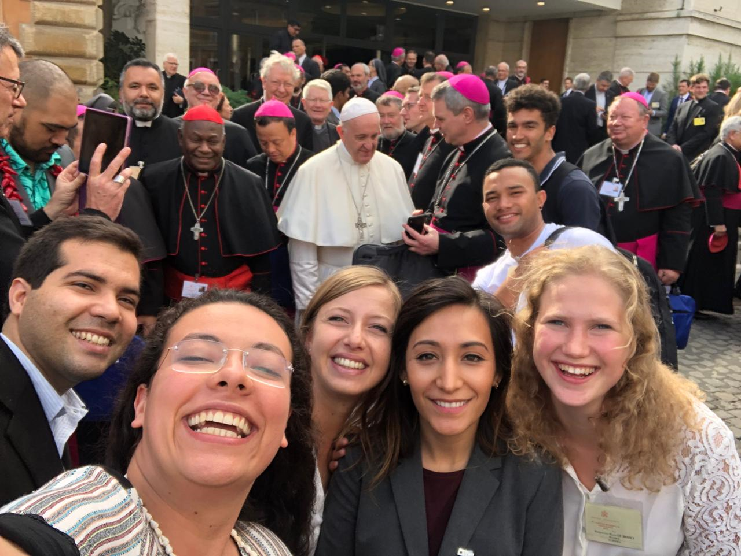
Thinking together fundamental equality and inescapable difference
In a context of « conflictual » equality

Slide 28
Dealing with the alterity/difference
The difference between men and women as the matrix of all differences
The question of unity in diversity
The need for listening and dialogue
The culture of « encounter »
A path of conversion and reconciliation between men and women in the Church
Sons and daughters of God
Equal but different

Slide 29
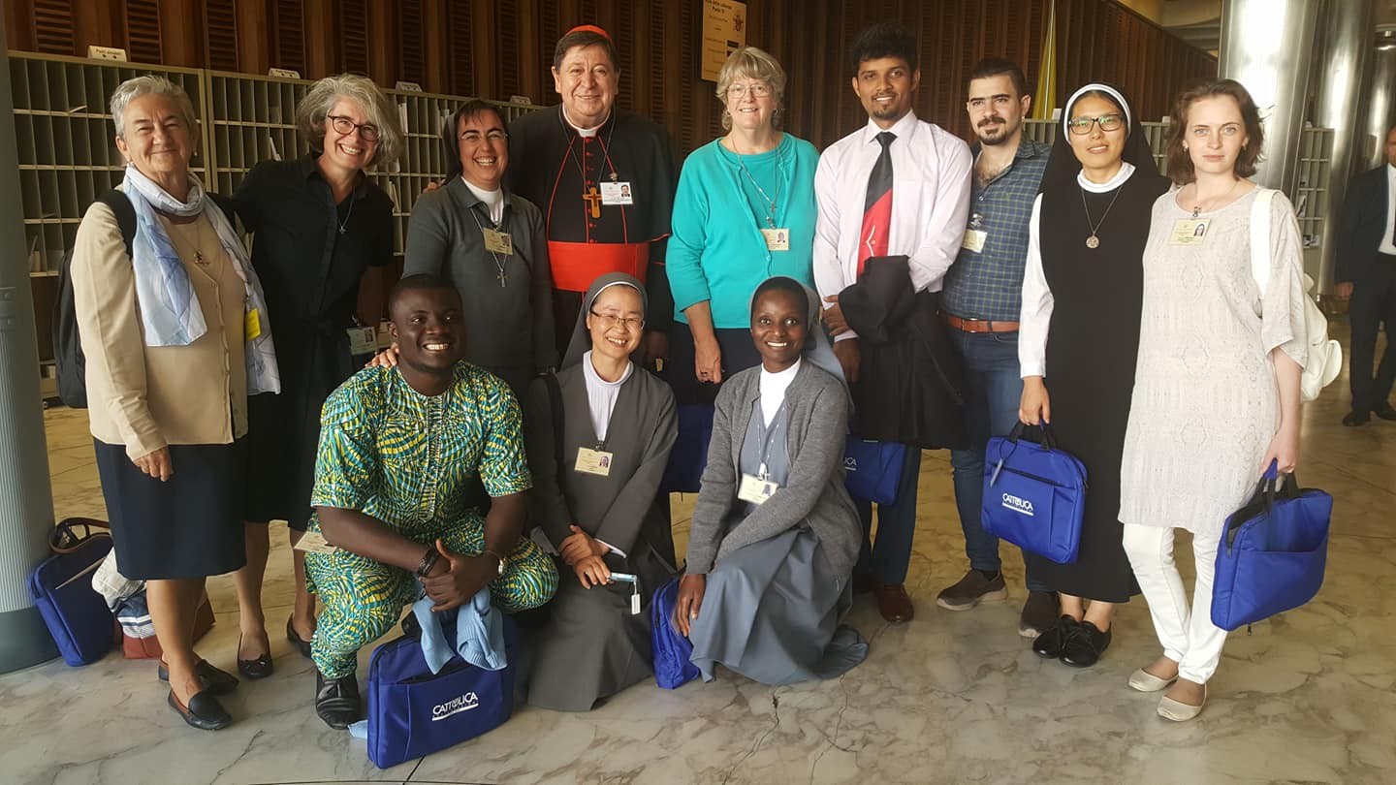
From domination/competition to reciprocity/cooperation

Slide 30
The challenge to listen
The synods as a process of listening to the cries of the victims, the cries of the women
A sound box for women’s voice
A call for a greater recognition and greater valuing of women in society and in the Church.
« The Synod recommends that everyone be made more aware of the urgency of an inevitable change, not least on the basis of anthropological and theological reflection on the reciprocity between men and women” Synod of Youth FD §55
Notes:
Women in the Church
55. The young also clamour for greater recognition and greater valuing of women in society and in the Church. Many women play an essential part in Christian communities, but often it is hard to involve them in decision-making processes, even when these do not require specific ministerial responsibilities. The absence of the feminine voice and perspective impoverishes debate and the Church’s journey, depriving discernment of a precious contribution. The Synod recommends that everyone be made more aware of the urgency of an inevitable change, not least on the basis of anthropological and theological reflection on the reciprocity between men and women.
FD 55 Synod on Youth

Slide 31
The challenge to listen
The synods as a process of listening to the cries of the victims, the cries of the women
A sound box for women’s voice
A call for a greater recognition and greater valuing of women in society and in the Church.
« The Synod recommends that everyone be made more aware of the urgency of an inevitable change, not least on the basis of anthropological and theological reflection on the reciprocity between men and women” Synod of Youth FD §55
Notes:
Women in the Church
55. The young also clamour for greater recognition and greater valuing of women in society and in the Church. Many women play an essential part in Christian communities, but often it is hard to involve them in decision-making processes, even when these do not require specific ministerial responsibilities. The absence of the feminine voice and perspective impoverishes debate and the Church’s journey, depriving discernment of a precious contribution. The Synod recommends that everyone be made more aware of the urgency of an inevitable change, not least on the basis of anthropological and theological reflection on the reciprocity between men and women.
FD 55 Synod on Youth

Slide 32
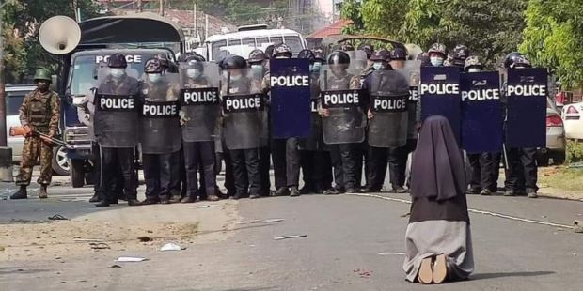
The need to listen to the clamour of women

Slide 33
The challenge to empower
Young women need role models and mentors
Women have often a lack of self-confidence and need empowerment and recognition
Women need to be empowered by leaders who are both women and men
The leadership of Pope Francis, new steps opening new gates

Slide 34
The importance of role models
CV 245. There is also a special need to accompany young men and women showing leadership potential, so that they can receive training and the necessary qualifications. The young people who met before the Synod called for “programmes for the formation and continued development of young leaders. Some young women feel that there is a lack of leading female role models within the Church and they too wish to give their intellectual and professional gifts to the Church. We also believe that seminarians and religious should have an even greater ability to accompany young leaders”.[133]

Slide 35
The challenge to implement co-responsability
Co-responsability as a key to handle this time of crisis in the society and in the Church
Synodality and the sensus fidei : communion, participation, mission
The Reform of the Curia and teamwork
Laudato Si and Fratelli Tutti

Slide 36
A focus on the baptismal call
Vocations, charisms and ministries
The novelty of instituted ministries for women (accolyte, lectorate, catechist)

Slide 37
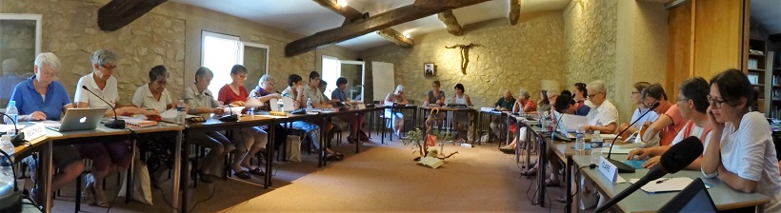
The challenge of creating a new leadership style
Servant leadership
Shared governance with men and women

Slide 38
A new style of leadership
Co-responsability and participation
Accompaniement and empowerment
A new relationship to the power
An exercise of the authority as an empowerment to liberate the liberty.
Cf FD 71 on The true sense of authority :
A generative force to activate and liberate the freedom.
Notes:
The true sense of authority
71. In order to undertake a true journey of maturation, the young need authoritative adults. In its etymological meaning, auctoritas indicates the capacity for enabling growth; it does not express the idea of a directive power, but of a real generative force. When Jesus encountered the young, in whatever state and condition they might find themselves, even if they were dead, in one way or another he said to them: “Arise! Grow!” And his word brought about what he was saying (cf. Mk 5:41; Lk 7:14). In the episode of the healing of the possessed epileptic (cf. Mk 9:14-29), which evokes so many of the forms of alienation experienced by young people today, it seems clear that Jesus stretches out his hand not to take away freedom but to activate it, to liberate it. Jesus fully exercises his authority: he wants nothing other than the growth of the young person, without a trace of possessiveness, manipulation or seduction.

Slide 39
The call for teamwork
Vision of collaborative leadership rooted in a conciliar theology of ministry articulated with the vision of synodality
Re-positioning of the leader as part of the community, bonded to and not separated from the people he/she serves
  → « copartners with the Spirit »
  → accountability, reflection and supervision
Fratelli Tutti « we are all connected »
Notes:
That means a practice of power within a synodal Church in an on-going process of discernment exercised from a pattern of servant leadership and collegiality. This requires teamwork and accountability, reflection and supervision, initial and ongoing formation, to put at the center relationships of interdependence and mutuality among ordained and lay ministers and between ministers and other missionary disciples.
http://www.vatican.va/roman_curia/synod/documents/rc_synod_doc_20181027_doc-final-instrumentum-xvassemblea-giovani_en.html
FD103 - It is worth noting, finally, that among the characteristics of our “being Church” that the young particularly appreciate are a readiness and a capacity for working collaboratively: in this way the formation of the young can be more significant, effective and incisive. The skill required for working collaboratively involves cultivating specific relational virtues: the discipline of listening and the capacity to give the other person space, readiness to forgive and willingness to “put oneself on the line”, according to a genuine spirituality of communion.

Slide 40
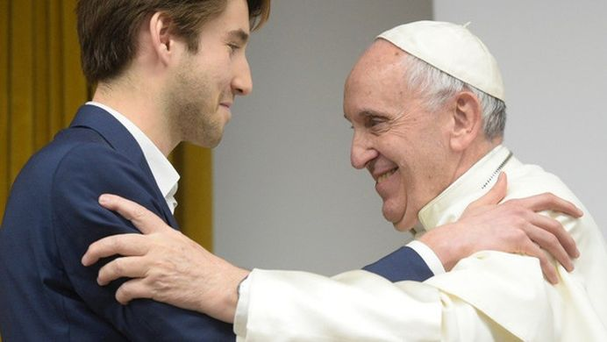
Pope Francis as a role model of « servant leadership » for a synodal Church
Availibility
Closeness
Tenderness
Confidence
Mutuality
Friendship/Fraternity as a goal/road
Bishop as both disciple and teacher
Notes:
Working Document for the Synod for the Amazon, June 17 2019
http://www.synod.va/content/sinodoamazonico/en/documents/pan-amazon-synod--the-working-document-for-the-synod-of-bishops.html
A synodal Church: disciple and teacher
92. Through mutual listening to peoples and nature, the Church transforms into a Church that goes out in both geographical and structural ways, and a Church that is sister and disciple through synodality. This is what Pope Francis made clear in the Apostolic Constitution Episcopalis Communio: “Hence the Bishop is both teacher and disciple ... he is a disciple when, knowing that the Spirit has been bestowed upon every baptized person, he listens to the voice of Christ speaking through the entire People of God” (EC 5). He himself became a disciple in Puerto Maldonado by expressing his willingness to listen to the voice of the Amazon.

Slide 41
The challenge to put synodality into practice
A style : discernment and fraternity
Modus vivendi et operandi
A vision and a practice
A culture and a spirituality
Processus and reform of the structures
The key role of leaders and protagonists
Notes:
Devenir un synode
“À la prière et à la proximité, je voudrais ajouter un troisième mot, qui vous est très familier : synodalité. Être Église, c’est être une communauté qui marche ensemble. Il ne suffit pas d’avoir un synode, il faut être un synode. L’Église a besoin d’un intense partage intérieur : un dialogue vivant entre les pasteurs et entre les pasteurs et les fidèles.”
Discours du pape François aux responsables de l’Église gréco-catholique ukrainienne, 5 juillet 2019
https://www.la-croix.com/Urbi-et-Orbi/Documentation-catholique/Actes-du-pape/Le-pape-Francois-responsables-greco-catholiques-ukrainiens-Lecoute-sensibilite-ouverture-opinions-freres-2019-08-22-1201042392

Slide 42
Synodality is rooted in the Trinity and sourced in the Eucharist
« The practice of synodality, traditional but always to be renewed, is the implementation, in the history of the People of God on their journey, of the Church as a mystery of communion, in the image of Trinitarian communion. As you know, this theme is very close to my heart: synodality is a style, it is walking together, and it is what the Lord expects of the Church in the third millennium » Pope Francis, Address to members of the International Theological Commission, November 29 2019
Notes:
http://www.vatican.va/content/francesco/en/speeches/2019/november/documents/papa-francesco_20191129_commissione-teologica.html

Slide 43
A dynamic and systemic vision
An integral ecclesiology
Relationship and community
Listening and dialogue
Participation and co-responsibility
Reciprocity and circularity
The enhancement of charisms
"Synodality is the secret of the links".
G. Costa, SJ, Special Secretary Youth Synod
Synodality is to come out of a competitive vision.
Notes:
Cf Vidéo Borras

Slide 44
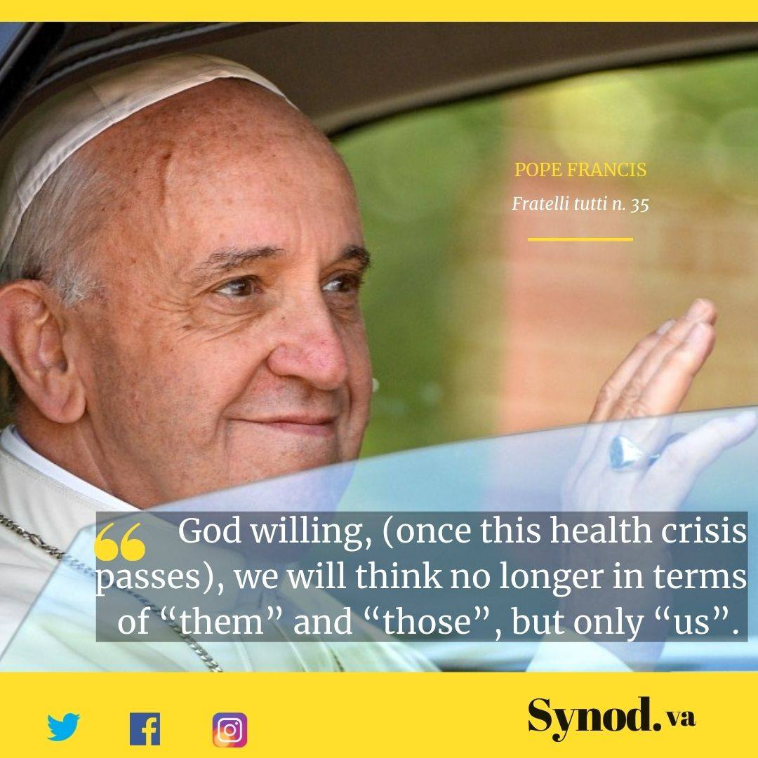
Synodality is passing from the “I” to the “us”

Slide 45
Synodality is a process that "ecclesializes" us.
"This stimulates the generation and implementation of processes that build us as the People of God rather than the search for immediate results with quick consequences. “
Letter of Pope Francis to the Church in Germany on the synod's journey
Notes:
Synodality comes to "ecclesialize" us,
To insert ourselves more deeply into the ecclesial "we", to awaken in us this fundamental communitarian and spiritual dimension,
Synodality helps us to "recover" that "constitutive" part of our baptism in the church which may have been covered by a culture of individualism and centuries of clericalism.
Towards a synodal Church with young people to return to the source and renew ourselves.

Slide 46
Rediscovering the primacy of the ecclesial "we" to serve the common good
QA 20 "Life is a community journey in which tasks and responsibilities are distributed and shared according to the common good.
Synodality awakens and strengthens the ecclesial "we".
Synodality aims at and produces communion at the service of the "common home".
Articulation Synodality &LaudatoSI/#FratelliTutti

Slide 47
Jesus, model of synodality
CV 29. “(…)Hence we can understand why, when Jesus returned from his pilgrimage to Jerusalem, his parents readily thought that, as a twelve-year-old boy (cf. Lk 2:42), he was wandering freely among the crowd, even though they did not see him for an entire day: “supposing him to be in the group of travellers, they went a day’s journey” (Lk 2:44). Surely, they assumed, Jesus was there, mingling with the others, joking with other young people, listing to the adults tell stories and sharing the joys and sorrows of the group. Indeed, the Greek word that Luke uses to describe the group – synodía – clearly evokes a larger “community on journey” of which the Holy Family is a part. Thanks to the trust of his parents, Jesus can move freely and learn to journey with others.”

Slide 48
Pilgrims together in a pilgrimage Church in this land
A "walk together" listening to the Spirit
A path of spiritual and pastoral conversion
An open path: accepting not to know in advance, not everything can be foreseen or framed, remaining open to the unpredictability and newness of the Holy Spirit.
We are in a transition phase and a learning process of synodality.

Slide 49
The images of synodality
The « invert pyramid »
The polyedron
The Church as a family
The road of Emmaüs
A new Pentecost
The « tent of meeting » Ex25
« In this way the Church presents herself as the “tent of meeting” in which the Ark of the Covenant is preserved (cf. Ex 25): a dynamic Church, in movement, which accompanies while journeying, strengthened by many charisms and ministries. Thus does God make himself present in this world
Notes:
Final Document 131
The life of the community
A mosaic of faces
131. A synodal and missionary Church is manifested through local communities with a variety of faces. The Church has never been rigidly monochrome, but she has developed as a polyhedron of persons with varying sensitivities, origins and cultures. In this way she has carried in the earthenware vessels of human frailty the incomparable treasure of Trinitarian life. The harmony that the Spirit gives does not abolish differences, but it makes them resonate together, generating a symphonic richness. This encounter between different persons in the one faith is the fundamental condition for pastoral renewal of our communities. This has a bearing on proclamation, on celebration and on service, that is, on the fundamental spheres of normal pastoral activity. Popular wisdom says that “it takes a village to rear a child”: this principle applies to all spheres of pastoral activity today.

Slide 50
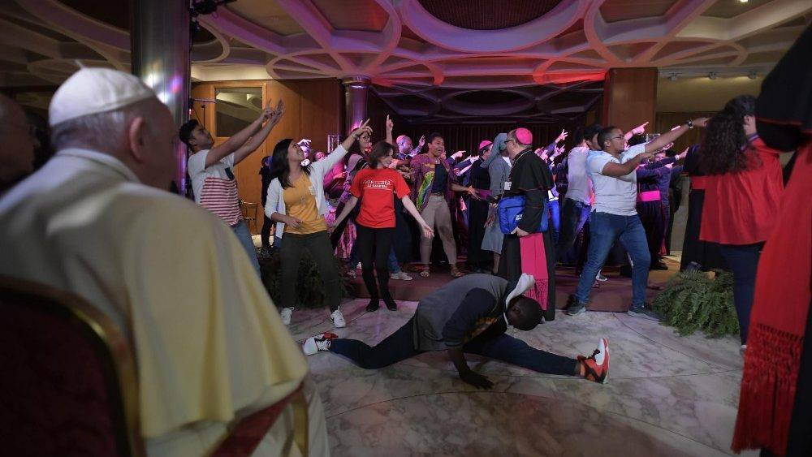
A dynamic church on the move
« A dance together »
Notes:
Francis, Letter to the People of God, August 20 2018
Together with those efforts, every one of the baptized should feel involved in the ecclesial and social change that we so greatly need. This change calls for a personal and communal conversion that makes us see things as the Lord does.
(…) It is impossible to think of a conversion of our activity as a Church that does not include the active participation of all the members of God’s People.

Slide 51
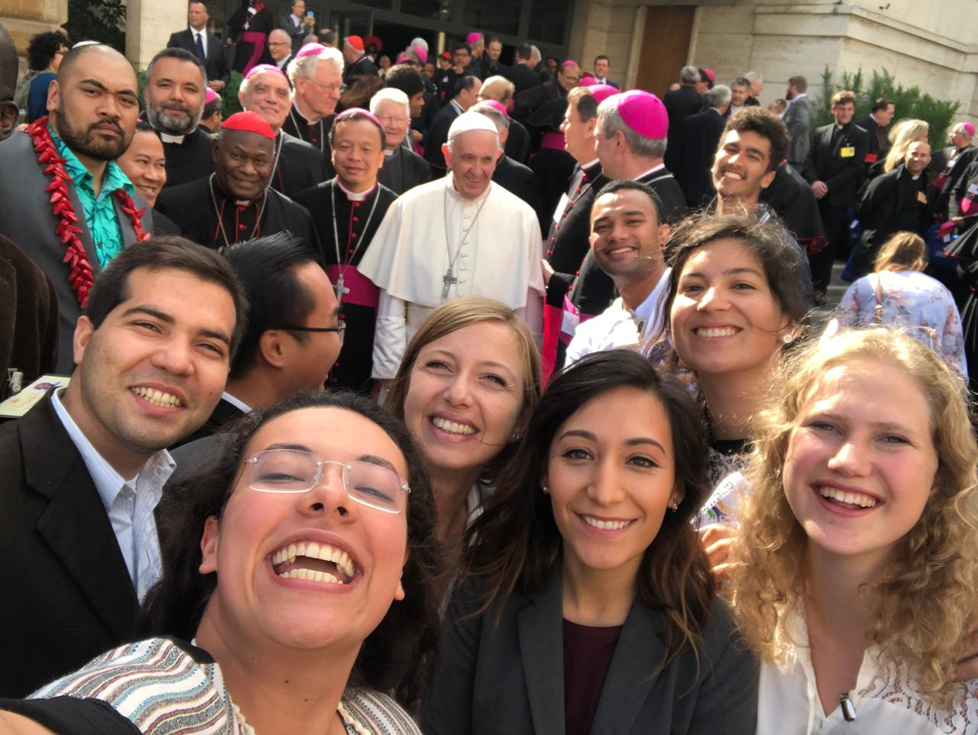
Let’s enter the dance of synodality

Slide 53
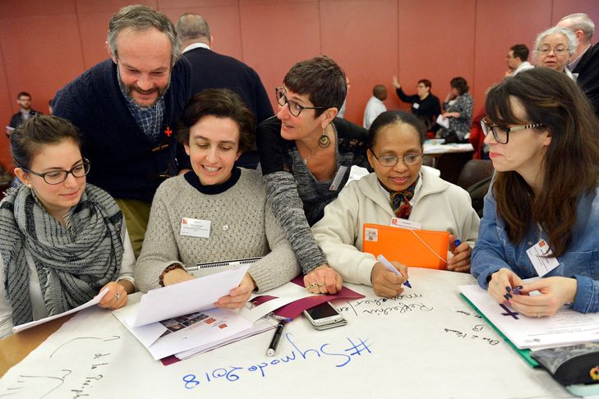
On the way to the Synod 2023

Slide 54
The contribution of women for the next synod

Slide 55
Synod 2021-2023
XVI Ordinary General Assembly of the Synod of Bishops
“For a synodal Church :
communion – participation – mission”

Slide 56
Towards a synodalization of the Church at all levels
« The Second Vatican Council gives an ideal of synodal and episcopal communion. We still have to make it grow, including at the parish level with regard to what is prescribed. There are parishes that have neither a pastoral council nor a council for economic affairs even though the Code of Canon Law obliges them to do so. Synodality is at stake here as well. “ Entretien exclusif de la Croix (Guillaume Goubert et Sébastien Maillard) avec le Pape François, 17 mai 2016
https://www.la-croix.com/Religion/Pape/Entretien-exclusif-avec-pape-Francois-integralite-2016-05-17-1200760636

Slide 57
Towards a synodal church
A synod 2021-2023 to foster synodality
“For a synodal Church : communion – participation – mission”
A new process beginning in the local churches with all the People of God
Notes:
https://www.youtube.com/watch?v=Xd2n44fbyOc&ab_channel=Synod.va
http://www.synod.va/content/synod/en/news/press-release--xvi-ordinary-general-assembly-of-the-synod-of-bis.html

Slide 58
Towards a synodal church
A synod 2021-2023 to foster synodality
Indeed, synodality refers to the very essence of the Church, her constitutive reality, and is thus oriented towards evangelization. (…)
It is an ecclesial way of being and a prophetic example for today's world. Since this is a unity in plurality in the power of the Spirit, the Church is called to open new paths whilst embarking on that same journey.
Notes:
“For just as the body is one and has many members, and all the members of the body, though many are one body, so it is with Christ.” (1 Cor 12:12). In a similar way, Augustine speaks of the Whole Christ (cf. Sermon 341), head and members who form an indivisible and inseparable unity. Only in union with Christ the head, is it possible to understand the plurality of the members of the body, which enriches the Church, overcoming any temptation to uniformity.

Slide 59
Towards a synodal church
A synod 2021-2023 to foster synodality
The Synod of Bishops is the dynamic point of convergence that calls for mutual listening to the Holy Spirit at every level of the Church's life. (1) It is not just an event, but also a process that involves in synergy the People of God, the College of Bishops and the Bishop of Rome, each according to their proper function (2)
Notes:
1/ cf. Address of His Holiness, Pope Francis, Ceremony Commemorating the 50th anniversary of the institution of the Synod of Bishops, 17 October 2015).
2/cf. Address by Cardinal Mario Grech to the Holy Father in the Consistory for the creation of new cardinals, November 28, 2020).

Slide 60
Purpose of the next synod : walking together
By walking together, and together reflecting on the path travelled, experiencing which synodal processes can help it to live communion, to achieve participation, to be open to mission.
A walk together to implement and manifest the nature of the Church as the People of God on a journey, a sign and instrument "of intimate union with God and of the unity of the whole human race" (LG1), in solidarity with whom she walks.

Slide 61
From the event to the process
The newness of Episcopalis communio
Art. 4
Phases of the Synod Assembly
Each Synod Assembly unfolds in a series of phases:
the preparatory phase
the discussion phase
and the implementation phase.

Slide 62
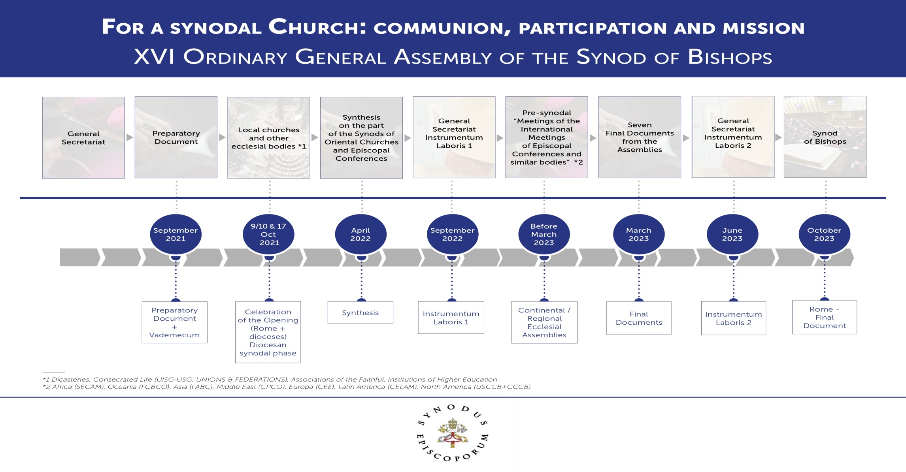
The process for the next synod

Slide 63
The process for the next synod

Slide 64
The process for the next synod

Slide 65
Under the agency of the Spirit
EC 7 « In the Church the purpose of any collegial body, whether consultative or deliberative, is always the search for truth or the good of the Church. When it is therefore a question involving the faith itself, the consensus ecclesiae is not determined by the tallying of votes, but is the outcome of the working of the Spirit, the soul of the one Church of Christ” »
Notes:
http://www.vatican.va/content/francesco/en/apost_constitutions/documents/papa-francesco_costituzione-ap_20180915_episcopalis-communio.html

Slide 66
Bringing synodal institutions to life
the Synod of Bishops or the Diocesan Synod
a diocesan or parish pastoral council, a presbyteral council
a local, provincial or general chapter for religious communities
General assemblies and councils of Church movements
Synodality requires meeting

Slide 67
To be part of the synodal process
To promote and support it
To name a referent/contact person
To share best practices of discernment in common,
To contribute to a spirituality of synodality
To train people to discernement and synodality
To foster a collaboration with pastors
To bring the voices of all, especially women, youth, children, poors

Slide 68
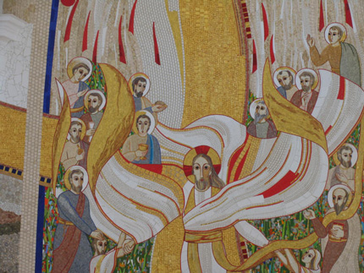
Synodality as an art
The art of the mosaïc - A poetic vision of synodality
Notes:
Francis’ Government: What is the driving force of his pontificate?
Antonio Spadaro, SJ / Pope Francis / CIVILTA CATTOLICA; 5 September 2020
This way of proceeding is called “discernment.” It is the discernment of God’s will in life and history. Although it is done in the realm of the heart, of interiority, its raw material is always the echo of reality that reverberates in inner space. It is an interior attitude that urges us to be open to dialogue, to encounter, to find God wherever He is found, and not only in predetermined, well-defined and fenced-in perimeters.
And above all, there is no discernment regarding ideas, even ideas of reform, but on the real, on stories, on the concrete history of the Church, because reality is always superior to the idea.^{[9]} For this reason the starting point is always historical and consists primarily in recognizing that “God works and labors for me in all things created on the face of the earth.”^{[10]} Actions and decisions, therefore, must be accompanied by a careful, meditative, prayerful reading of experience. And the life of the spirit has its own criteria. For example, when a proposal for reform is made, for Francis it is not only the proposal itself that is important, but also the spirit – good or bad – that carries it forward. This emerges not only from what is proposed, but also from the way, the language in which that proposal is expressed. The Spiritual Exercises of St. Ignatius, after all – as the semiotician Roland Barthes^{[11]} had well understood – generate a language that gives priority to discernment note from the pope shared with La Civiltà Cattolica

Slide 69
The need to inculturate synodality
Interaction between synodality and a socio-political culture
No unique way or process, no unique technique, pedagogy or practice for synodality
Each local church, organization, community… has its own culture/charism/spirituality and has to discern how to implement synodality
Notes:
Cf African way to speak of synodality related to the notion of Church-Family, or in Latin America experience of CELAM, context of North America with multiculturalism and polarization/Europe France
Example young auditor from Russia after the synod on youth or op/sj

Slide 70
References
All documents on the official website of the synod http://www.synod2018.va/
Key Documents on Sinodality
  A key short text of Pope Francis Oct 2015 http://w2.vatican.va/content/francesco/en/speeches/2015/october/documents/papa-francesco_20151017_50-anniversario-sinodo.html
  For a deeper exploration a new document of the International theological commission March 2018 http://www.vatican.va/roman_curia/congregations/cfaith/cti_documents/rc_cti_20180302_sinodalita_en.html
  New Apostolic Constitution on the synod of bishops Sept 2018 http://w2.vatican.va/content/francesco/en/apost_constitutions/documents/papa-francesco_costituzione-ap_20180915_episcopalis-communio.html

