Slide 1
Pontifical Council for the Laity Women’s Section
A greeting to WUCWO’s General Assembly
23° October 2014
Ana Cristina Villa Betancourt

Slide 2
1. Looking at the history of WUCWO’s relationship to the Holy See
A quick look…

Slide 3
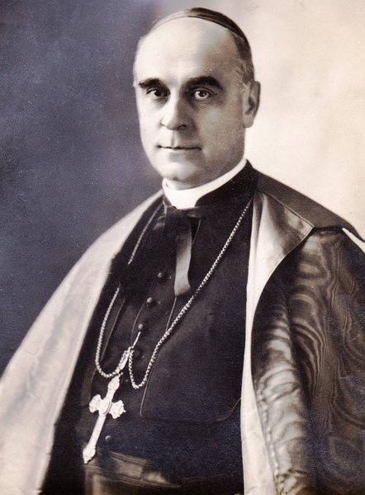
Raphael Card. Merry del Val (1865-1930)
Cardinal Protector of the International League of Catholic Women, 1922 - 1930

Slide 4
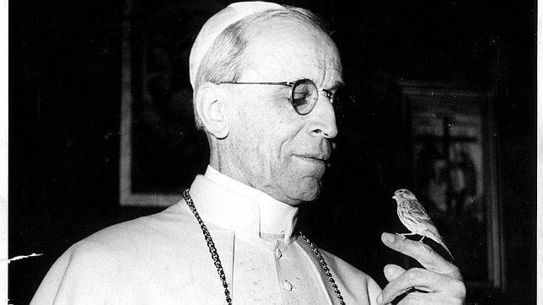
Pope Pius XII
We are convinced that women can make a great contribution to the cause of peace. We address this paternal Message to you, mothers, wives, daughters of every nation, and you in particular, Catholic Women. We are aware of your filial devotion to the Vicar of Christ, and through Him to Jesus himself ... We are always anxious to promote the work of peace in every way until its light envelops the earth forever, and so we wish to entrust to you, beloved daughters..., the arduous but sublime office of working for peace.
Pius XII, Speech to participants of WUCWO Congress, April 1952,
available from www.vatican.va only in Italian, PCL’s translation.

Slide 5
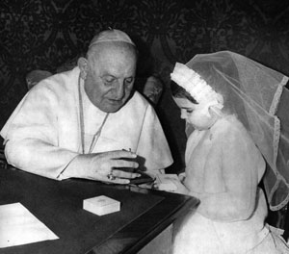
Pope John XXIII
Dear daughters, the excellent work undertaken by your organisation over a half century – with this beautiful title of World Union – is the best guarantee that you will know what to do for the Christian renewal of society. Society resembles families, and they in turn reflect women who are the true heart of the home. Be therefore proud of your noble mission to which the Church calls you through our humble voice. May the divine grace that we wholeheartedly call upon to shower abundantly upon you, your families and all those whom you represent, make your work fruitful!
John XXIII, Speech to participants of WUCWO Congress, May 1961,
available from www.vatican.va only in Spanish, PCL’s translation.

Slide 6
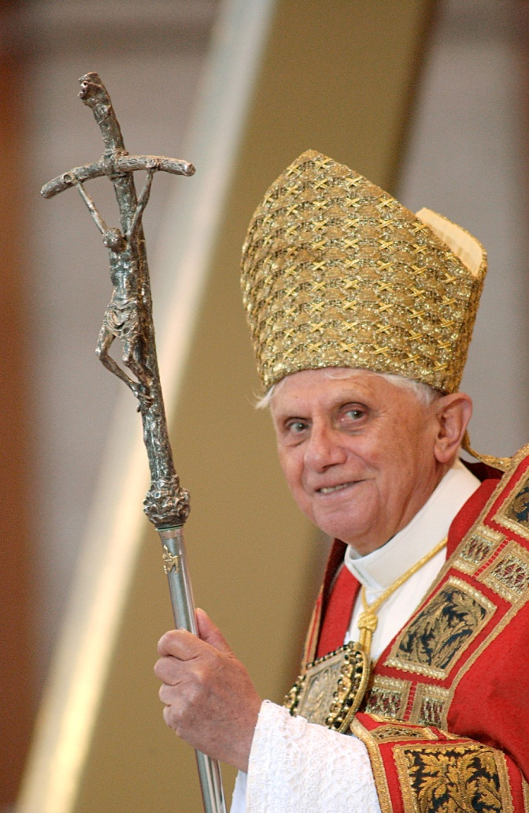
“He that does not give God, gives too little”
Pope Benedict XVI – Message for Lent 2006

Slide 7
2. Missionary Conversion
Allowing Evangelii Gaudium to interrogate us

Slide 8
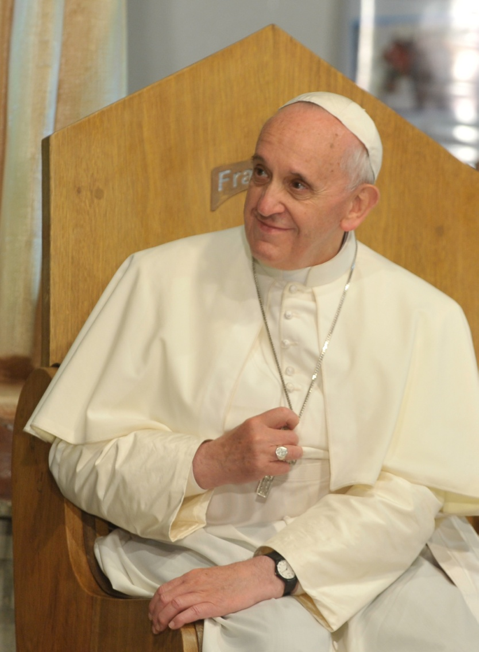
The joy of the gospel fills the hearts and lives of all who encounter Jesus. Those who accept his offer of salvation are set free from sin, sorrow, inner emptiness and loneliness. With Christ joy is constantly born anew. In this Exhortation I wish to encourage the Christian faithful to embark upon a new chapter of evangelization marked by this joy, while pointing out new paths for the Church’s journey in years to come.
EG 1

Slide 9
I invite all Christians, everywhere, at this very moment, to a renewed personal encounter with Jesus Christ, or at least an openness to letting him encounter them; I ask all of you to do this unfailingly each day. No one should think that this invitation is not meant for him or her, since “no one is excluded from the joy brought by the Lord”. The Lord does not disappoint those who take this risk; whenever we take a step towards Jesus, we come to realize that he is already there, waiting for us with open arms. Now is the time to say to Jesus: “Lord, I have let myself be deceived; in a thousand ways I have shunned your love, yet here I am once more, to renew my covenant with you. I need you. Save me once again, Lord, take me once more into your redeeming embrace”.
EG 3

Slide 10
Evangelii Gaudium
provides us with a few points
for an
Examination of Conscience

Slide 11
1. Lack of Joy
Why do our lives so often seem a Lent without Easter? (EG 6)
Whenever our interior life becomes caught up in its own interests and concerns, there is no longer room for others, no place for the poor. God’s voice is no longer heard, the quiet joy of his love is no longer felt, and the desire to do good fades. This is a very real danger for believers too. Many fall prey to it, and end up resentful, angry and listless. (EG 2)

Slide 12
2. Lack of Missionary Enthusiasm
“a sort of inferiority complex” which leads us to conceal or water-down our Christian identity;
“a kind of obsession about being like everyone else” (EG 79);
a “practical relativism” that “consists in acting as if God did not exist” (EG 80)
Desiring “for power or human glory at all cost, rather than giving their lives to others in mission” (EG 80)
LET US NOT ALLOW OURSELVES TO BE ROBBED OF MISSIONARY ENTHUSIASM! (EG 80)

Slide 13
3. Hopelessness
…we risk being disenchanted, and “diminishing our commitment and our fervor”
But the “eyes of faith” allow us to “see the light which the Holy Spirit always radiates in the midst of darkness, never forgetting that ‘where sin increased, grace has abounded all the more” (EG 84)
LET US NOT ALLOW OURSELVES TO BE ROBBED OF HOPE! (EG 86)

Slide 14
4. Lack of community life, lack of fraternal love
To live true encounter with others, “to accept and esteem them as companions along the way, without interior resistance… finding Jesus in the faces of others, in their voices, in their pleas.” (EG 91)
To form a “community which is the salt of the earth and the light of the world” (EG 92)
LET US NOT ALLOW OURSELVES TO BE ROBBED OF COMMUNITY! (EG 92)
LET US NOT ALLOW OURSELVES TO BE ROBBED OF THE IDEAL OF FRATERNAL LOVE! (EG 101)

Slide 15
5. Spiritual Worldliness
“consists in seeking not the Lord’s glory but human glory and personal well-being… one’s own interests and not those of Jesus Christ.” (EG 93);
it looks on “from above and afar, … reject the prophecy of their brothers and sisters,… discredit those who raise questions… constantly point out the mistakes of others and are obsessed by appearences”.
The remedy is… “breathing the pure air of the Holy Spirit who frees us from self-centredness”, from “an outward religiosity bereft of God” (EG 97).
LET US NOT ALLOW OURSELVES TO BE ROBBED OF THE GOSPEL! (EG 97)

Slide 16
As a conclusion…

Slide 17
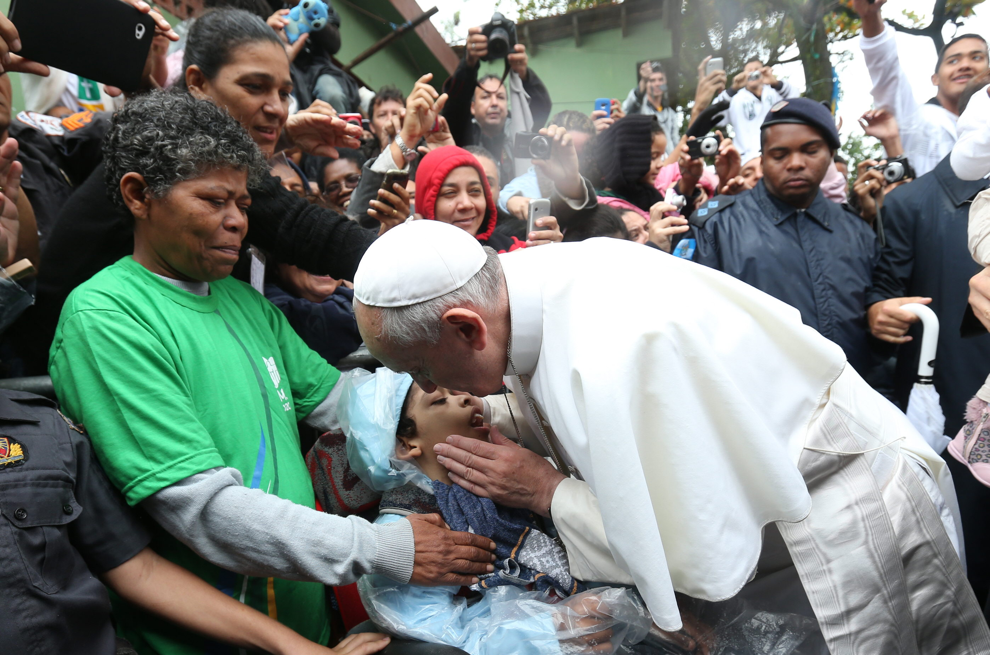

Slide 18
“My mission of being in the heart of the people is not just a part of my life or a badge I can take off; it is not an ‘extra’ or just another moment in life. Instead, it is something I cannot uproot from my being without destroying my very self.
I am a mission on this earth; that is the reason why I am here in this world. We have to regard ourselves as sealed, even branded, by this mission of bringing light, blessing, enlivening, raising up, healing and freeing.”
EG 273

Slide 19
THANK YOU!

